Slide 1

Empowering Renewable Energy for Sustainable Development 31/05/24 to 30/07/24
Presented by:
DEEPAK JHA
Computer Science and Engineering
Enrollment Number: 21CS002312
Supervisor: DR. RUCHI DOSHI DIRECTOR & CEO (ResAIShala)

Slide 2
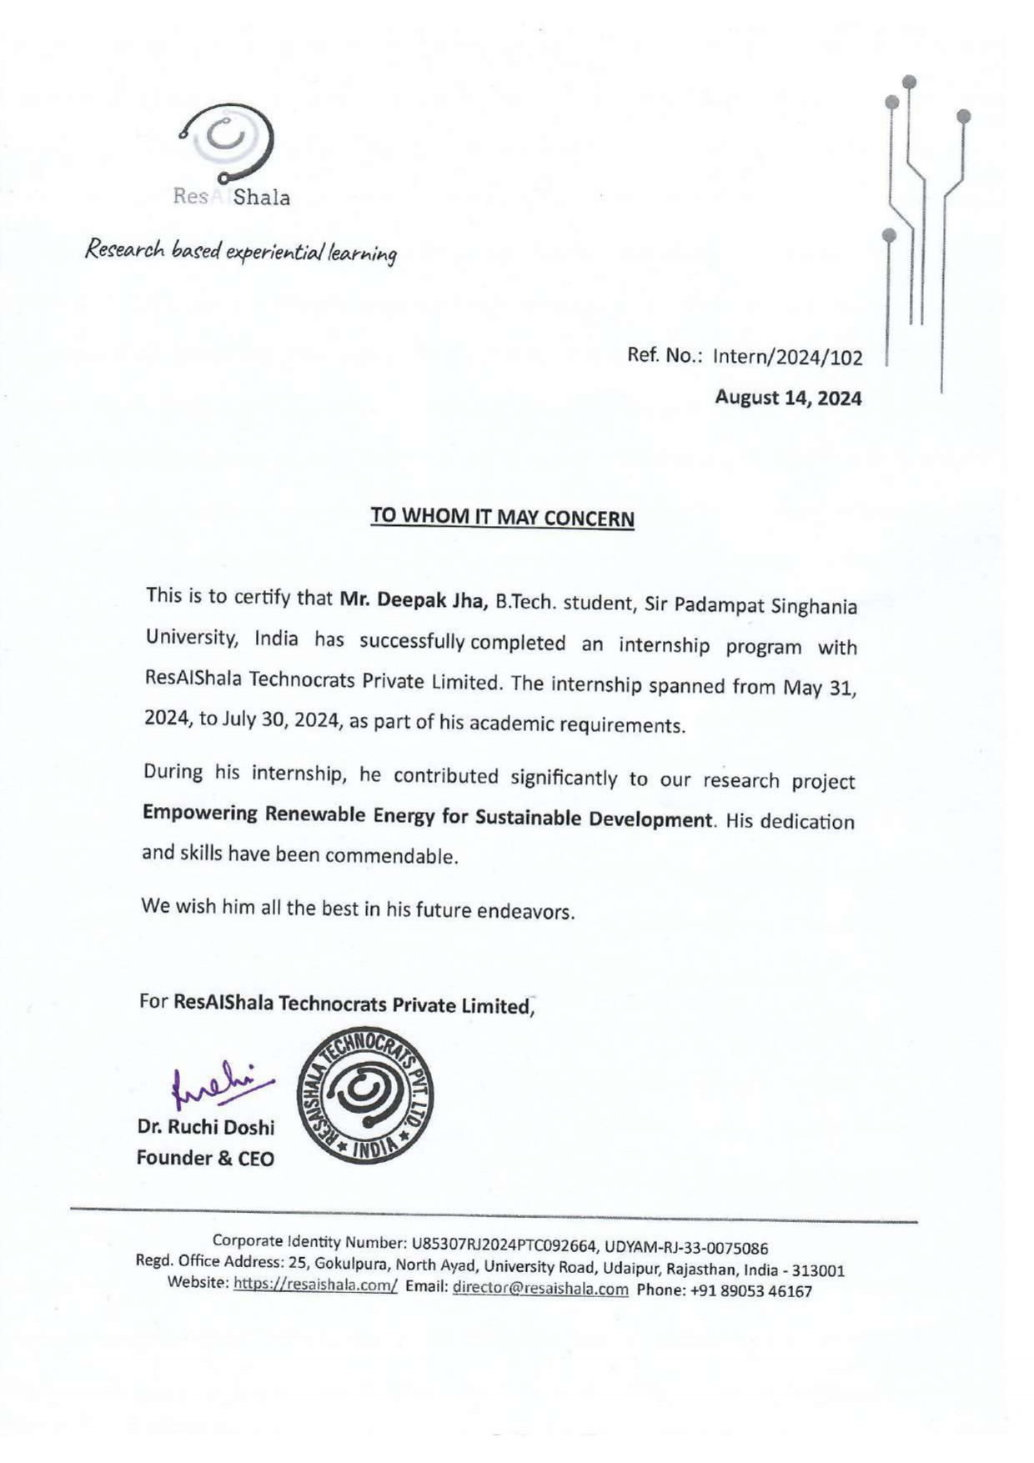
Internship Certificate

Slide 3
Introduction
Company Name and Brief Description:
ResAIShala Technocrats Pvt. Ltd. is an innovative startup dedicated to transforming the learning experience by providing hands-on education in emerging technologies. Specializing in fields such as Artificial Intelligence, Robotics, and the Internet of Things (IoT), ResAIShala aims to bridge the gap between traditional education and the skills required for the future workforce. With a commitment to excellence, innovation, and inclusivity, the company empowers learners of all ages to become future leaders and innovators through comprehensive courses, expert instruction, and a supportive community.
Overview of the Internship Program:
During my research internship at ResAIShala, I was immersed in an environment that emphasized the practical application of cutting-edge technologies such as Machine Learning, Big Data, and the Internet of Things (IoT). The internship provided a platform for conducting in-depth research, resulting in the creation of multiple research papers. The highlight of my internship was the successful publication of a paper in IEEE, demonstrating my ability to contribute meaningful and impactful research to the field.

Slide 4
Introduction
Importance of the Internship:
The internship was pivotal in advancing my research skills, particularly in the areas of Big Data Analytics and Renewable Energy. Your most significant involvement was in authoring and publishing the paper titled "Empowering Renewable Energy: A Comprehensive Analysis of Big Data Analytics in Innovation, Efficiency, and Sustainability." This paper explores the transformative role of Big Data Analytics in enhancing renewable energy technologies. It highlights critical applications such as grid management, optimization algorithms, and predictive analytics, demonstrating how Big Data can drive innovation and improve efficiency in the renewable energy sector.
CSE
Deepak Jha
4

Slide 5
Internship Objectives
Duration: 2 Months (31/05/24 to 30/07/24)
Location: Udaipur, Rajasthan
Internship Type: Full-time
Company's Expectations:
Conducting in-depth research on emerging technologies such as AIML, Robotics, and the Internet of Things (IoT).
Authoring research papers on topics related to Big Data Analytics and Renewable Energy, specifically focusing on how these technologies can drive innovation and efficiency in the renewable energy sector.
Utilizing advanced tools and methodologies to analyze data and develop insights that contribute to academic and practical advancements.

Slide 6
Internship Objectives
Internship Objective:
Successfully authored and published a research paper titled "Empowering Renewable Energy: A Comprehensive Analysis of Big Data Analytics in Innovation, Efficiency, and Sustainability" in IEEE.
Explored and documented how Big Data Analytics can enhance renewable energy technologies, including applications in grid management, optimization algorithms, and predictive analytics.
Demonstrated a significant contribution to understanding and advancing the role of emerging technologies in addressing global challenges like climate change.
CSE
Deepak Jha
6

Slide 7
Key Project & Responsibilities
Project Title: Empowering Renewable for Sustainable Development
The project focused on analyzing the impact of Big Data Analytics on renewable energy technologies, aiming to enhance innovation, efficiency, and sustainability.
Conducted comprehensive research and analysis on the role of Big Data in renewable energy. Authored the research paper that was published in IEEE, detailing key applications such as grid management and predictive analytics.
Developed a website on demand management in smart grids to complement the research
Technologies/Tools used: Big Data Analytics, Google Trends, Overleaf, HTML, CSS, JavaScript, Python, and Flask.
List of Skills: Research and Data Analysis, Python, JavaScript

Slide 8
Project Description
Project Description: Its goal was to showcase innovative applications that improve efficiency and sustainability, ultimately providing insights into integrating Big Data for better grid management and predictive maintenance.
Focus on impact: The project significantly advanced the understanding of how Big Data can be leveraged to improve renewable energy systems. The website shows how a user can control their electricity use by reviewing their total energy consumption. It also promotes towards sustainable development by encouraging user to use solar panels.
Key Achievements/Outcomes: Published a research paper in IEEE in International Conference on 2024 Emerging Trends in Networks and Computer Communications (ETNCC). Also developed a functional website for demand management, enhancing practical application of research findings.

Slide 9
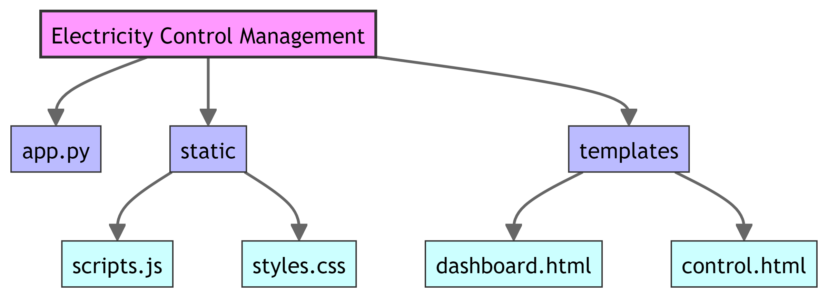
Project Description
Visuals:
File Structure
CSE
Deepak Jha
9

Slide 10
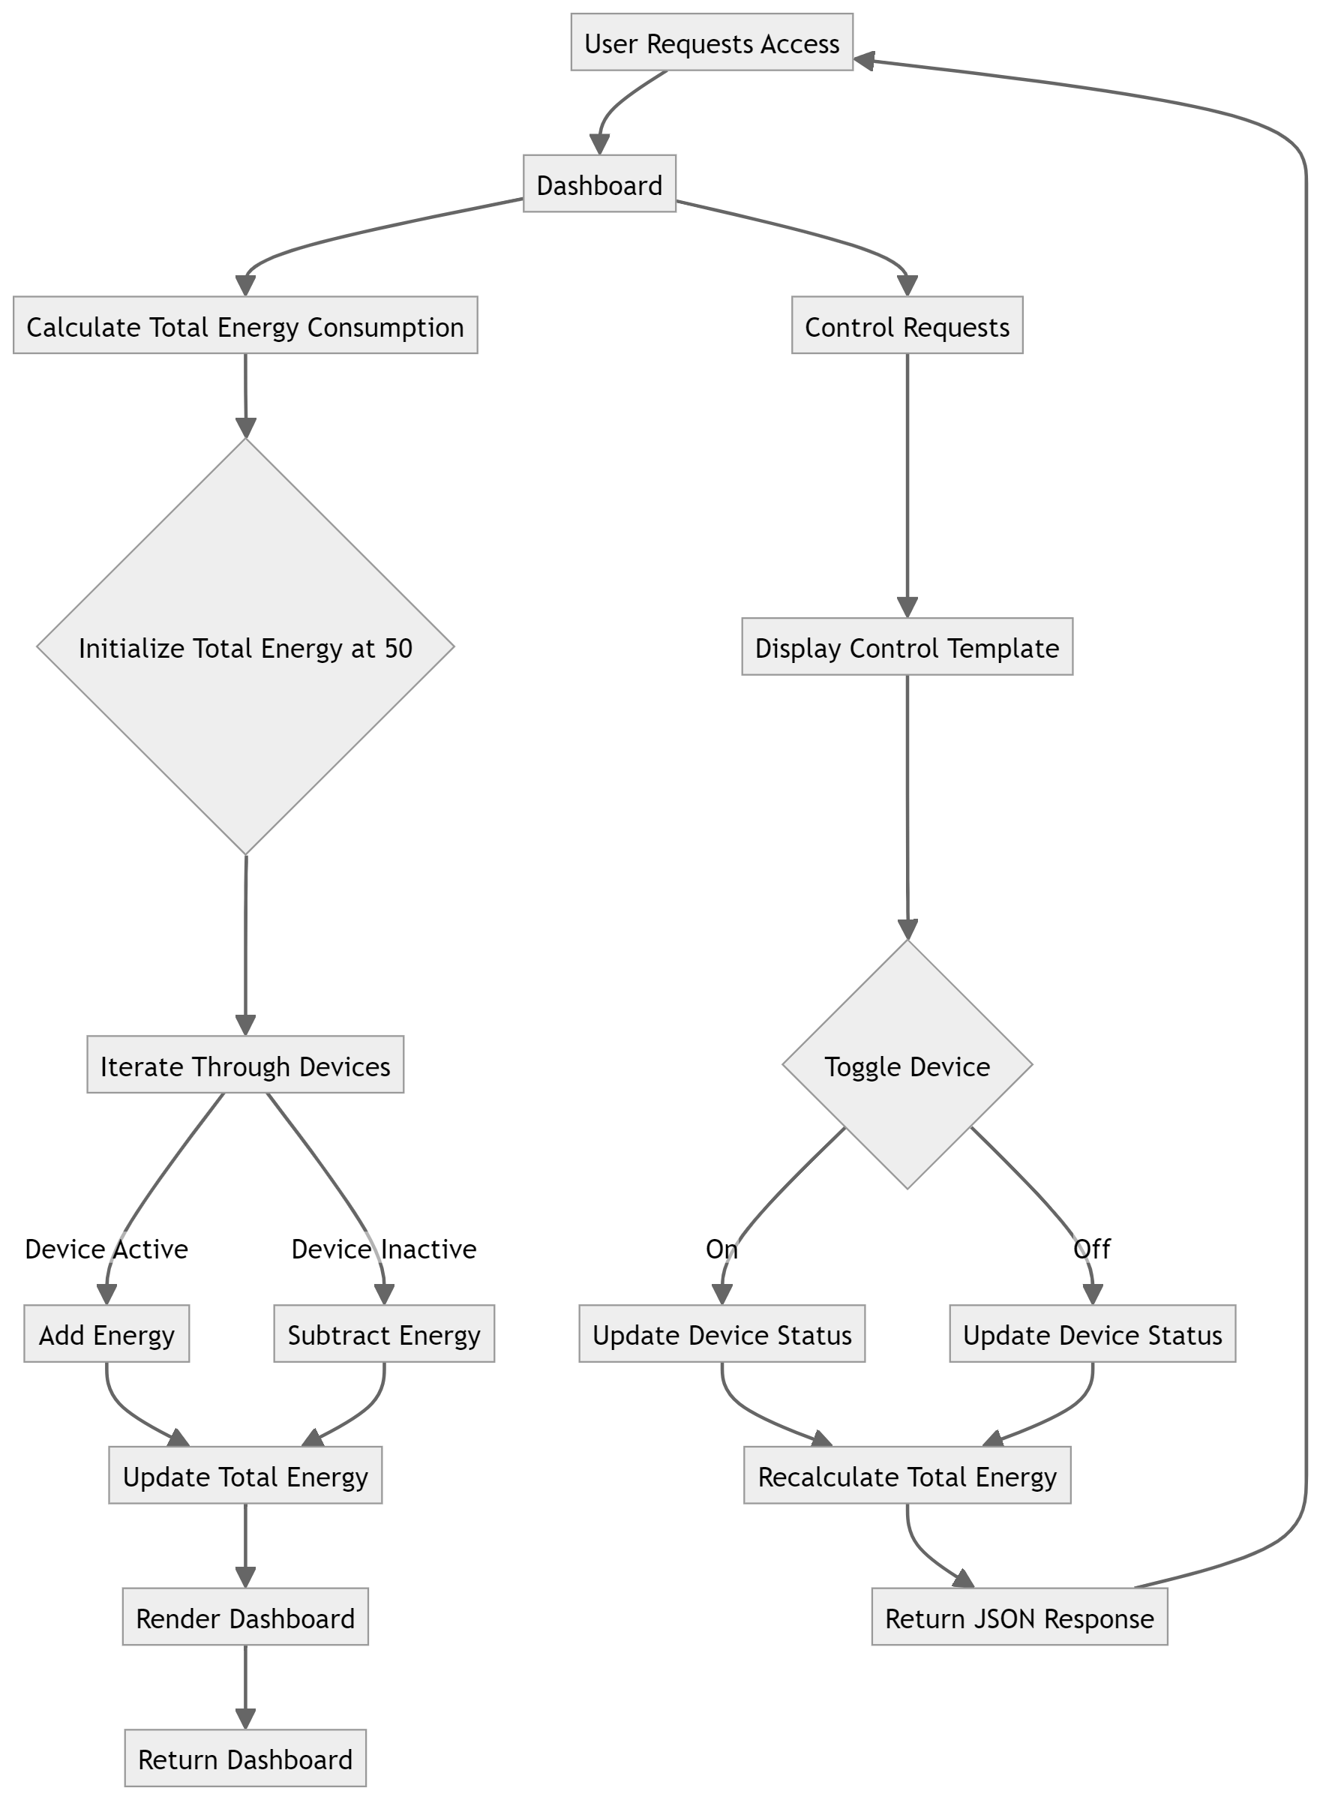

Slide 11
Lessons Learned
Key Takeaways:
User Interface: The system was designed with a user-friendly control page for toggling device statuses.
Energy Calculation: A robust algorithm calculates the total energy consumption, taking device statuses into account.
API Integration: A well-defined API enables seamless interaction with the client, exchanging data and providing a JSON response.
Challenges Overcome: The system that manages devices and their energy consumption. It handles user interactions, data updates, and communication with the client. The system is not scalable and does not handles dynamic data updates efficiently.

Slide 12
Conclusion and Results
The "Empowering Renewable for Sustainable Development" project effectively highlighted how Big Data Analytics can revolutionize renewable energy technologies. It identified innovative applications for grid management and predictive maintenance, offering crucial insights into enhancing efficiency and sustainability. The research, published in IEEE, underscored the project's impact, while the development of a demand management website provided a practical tool that demonstrated these concepts in action. Together, these efforts advanced both theoretical understanding and practical solutions, contributing to a more efficient and sustainable energy future. Big data analytics has the ability to revolutionize the field of renewable energy research and accelerate the shift to sustainable energy sources. Stakeholders may maximize energy creation, distribution, and consumption by utilizing massive volumes of data from many sources, such as weather forecasts, energy production data, and grid operations. This will raise the efficiency, depend ability, and affordability of renewable energy systems. Big data analytics will be crucial in enabling new opportunities and optimizing the potential of renewable energy as it remains an essential element in tackling global issues like energy security and climate change.

Slide 13
Future Work
Improved Predictive Analytics: Upcoming advancements in this field will concentrate on raising the precision and level of detail in projections for renewable energy. This includes applying cutting-edge machine learning methods to better understand complicated linkages and non-linear dynamics in renewable energy systems, such as ensemble models and deep learning.
Edge Computing: Real-time data processing and analytics at the network’s edge, nearer renewable energy sources, will be possible with the rise of edge computing technology. The responsiveness and efficiency of renewable energy systems will be improved by this decentralization of computing resources, especially in situations when energy generation is dispersed or remote.
Integration with IoT and Sensor Networks: More thorough monitoring and control of renewable energy sources will be made possible by the integration of big data analytics with Internet of Things (IoT) devices and sensor networks.

Slide 14
Mentor Contact Information
Mentor / Coordinator:
Name: Dr. Kamal Kant Hiran
Email: resaishala@gmail.com
Phone Number: +91 8860209177
Department Office:
Address: 25, Gokulpura, North Ayad, University Road, Udaipur
Website: https://resaishala.com/

